Slide 1
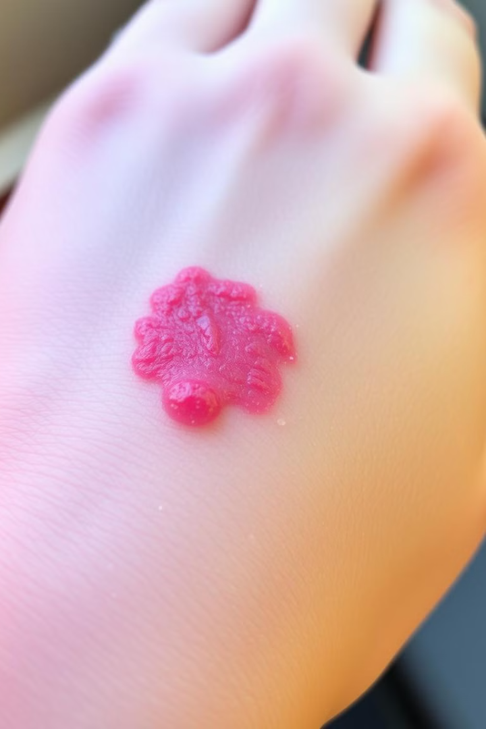
Eczema Diagnosis System: A Knowledge-Based Approach Using Streamlit

Slide 2
Problem Statement
Objective
Importance
To create a system that aids users in diagnosing potential eczema conditions based on symptoms.
Eczema affects millions and requires timely attention. Early identification can prevent complications.

Slide 3
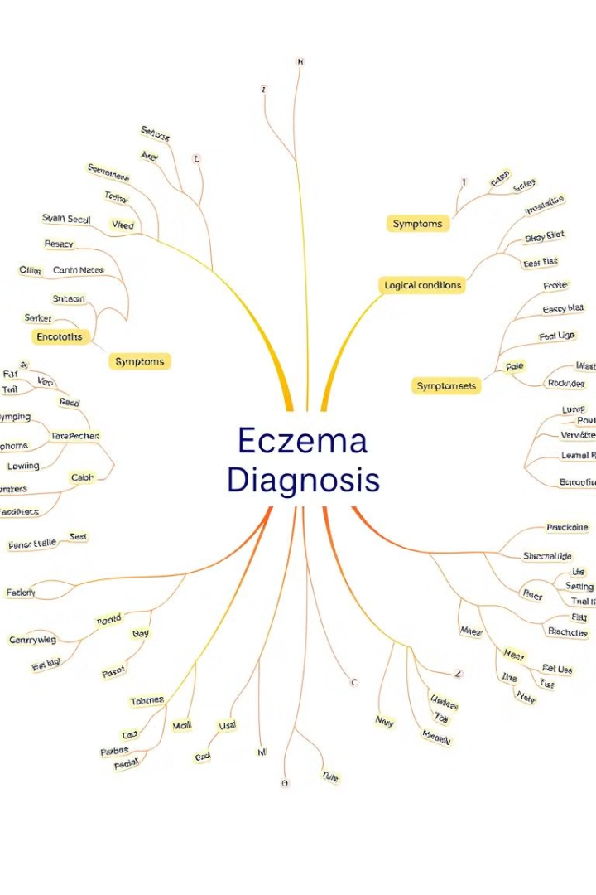
Knowledge Representation Techniques
Symptoms Categorization
Rule-Based Diagnosis
Logical conditions define diagnosis outcomes. Intersection of input symptoms with predefined sets.
Universal Symptoms: Shared by all eczema types (e.g., rash, itchy skin). Type-Specific Symptoms: Symptoms linked to specific eczema types (e.g., blisters, swelling).

Slide 4
System Architecture
Frontend
Backend
Streamlit for user interaction and symptom input.
Python-based rule-checking system for diagnosis.

Slide 5
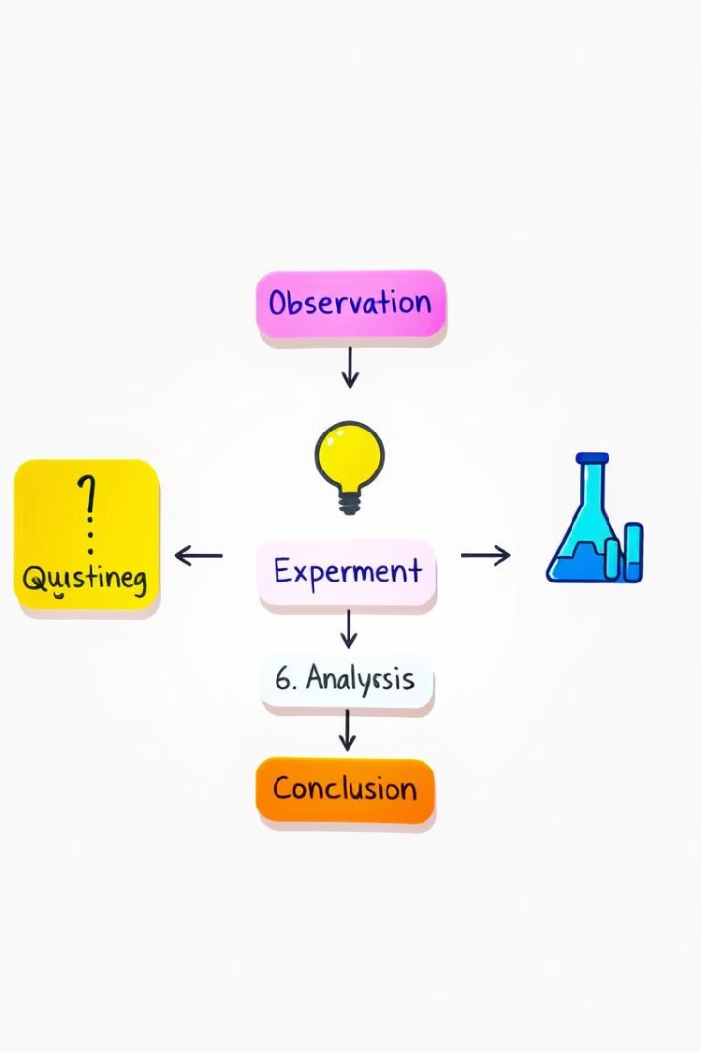
Reasoning Process
1
User selects symptoms from a checklist.
2
Symptoms are matched against predefined universal and type-specific categories.
3
Diagnosis is based on matching rules: Presence of all universal symptoms → Eczema confirmed.

Slide 6





Challenges and Solutions
Challenge: Handling ambiguous or incomplete input.
Solution: Provide a fallback message suggesting consultation with a doctor.
Challenge: Representing diverse eczema types.
Solution: Defined clear rule sets for each type.

Slide 7
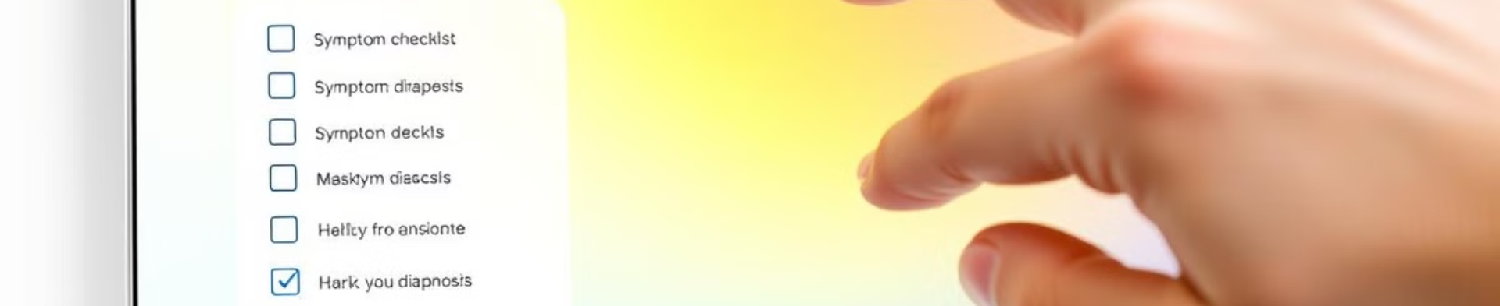

Demonstration
Input symptoms
Observe the diagnosis
The user can interact with the system through a user-friendly interface.
The system processes the input and displays the potential diagnosis.

Slide 8



Conclusion
1
Knowledge-based systems simplify medical diagnostics.
2
Streamlit ensures user-friendly interaction.
3
Future scope: Integrating additional skin conditions.

